Slide 1
Justin Pilecki

Slide 2
This Program includes a dynamically updated graph of Covid-19 cases per day – the coolest part of the program
This program contains a web scraped number of worldwide covid-19 cases from a website that updates each day
Using the Matplotlib library, a graph of dates and worldwide cases is presented in a line graph
Using this info, every day the page is updated, the graph updates dynamically with the newest data
This is cool because we can see the most up-to-date data using this program!

Slide 3
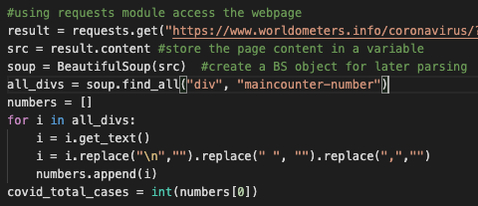

Slide 4
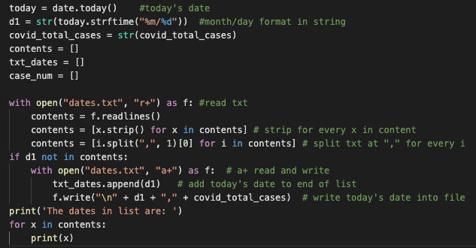

Slide 5
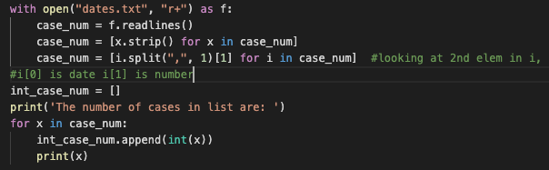

Slide 6
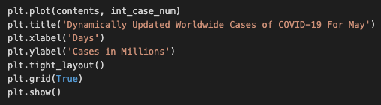

Slide 7
If I could do it all over again, I would…
Create more dynamically updated graphs! The most exciting part was coming up with such a practical and useful idea
This code’s use can last indefinitely even after this semester
Other graphs demonstrating recovery, mortality, and case fatality in dynamic updates would be helpful, as well as stratified by nation, but would require more time to implement

Slide 8
The thing that I learned the most was…
The Matplotlib library for designing, plotting, and representing graphs
Line graphs, bar graphs, pie charts
Labelling, percentages, colors, grids
Working with real-time data
Combining Beautiful Soup webscraping with Matplotlib Graphs
Some statistical info like case fatality

Slide 9
Python libraries are helpful and numerous!
There are many libraries in Python to choose from when starting a project such as this
It was fun to learn from tutorials about Matplotlib and apply this knowledge to the assignment
I look forward to continuing my study of Python even after the course ends, and find more time to seek out these libraries and how useful they can be to a programmer
Have a great summer

